Slide 1
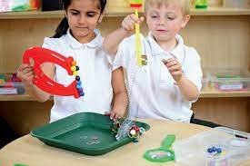
Working Scientifically Foundation Stage
I have my own ideas
I test my ideas
I notice similarities and differences
I question why things happen
I begin to use science words
I can use my senses and look closely
I can talk about things like plants, animals, natural, and found objects
I can create simple representations of people and objects
I use equipment and tools carefully

Slide 2
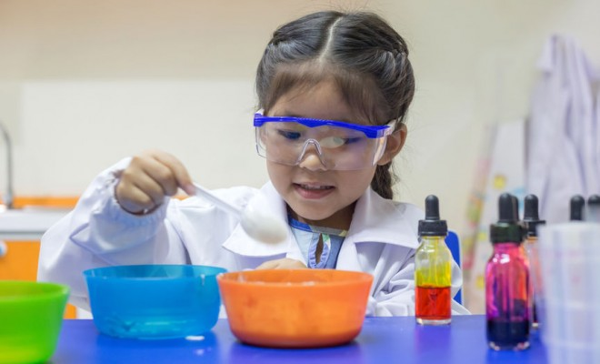
Working Scientifically in Key Stage One
I recognise that questions can be answered in different ways
I perform simple tests
I can compare things. I sort and group them
I ask simple questions
I use simple scientific language
I observe closely
I can talk about what I have found out
I gather and record simple data in different ways
I use equipment to make measurements

Slide 3

Working Scientifically in Lower Key Stage Two
I ask my own questions I use different ways to answer them
I set up my simple tests
I make careful observations
I suggest improvements and raise further questions
I use different equipment to measure accurately in standard units
I use relevant scientific language
I gather, record, classify and present data in different ways including drawings, labelled diagrams, keys, bar charts and tables
I explain what I have found out using speaking and writing
I draw simple conclusions and make predictions for new values

Slide 4
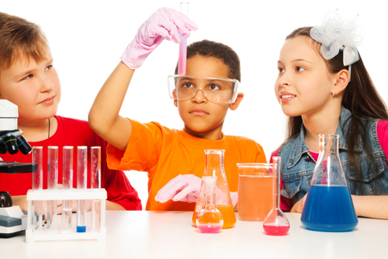
Working Scientifically in Upper Key Stage Two
I ask my own questions I use different ways to answer them
I set up my simple tests
I make careful observations
I suggest improvements and raise further questions
I use different equipment to measure accurately in standard units
I use relevant scientific language
I gather, record, classify and present data in different ways including drawings, labelled diagrams, keys, bar charts and tables
I explain what I have found out using speaking and writing
I draw simple conclusions and make predictions for new values

