Slide 1




Dance Progression Ladder
Intent:
Here at Sparken Hill we will ensure that pupils will cover all the requirements in the national curriculum for P.E. It is our intention to deliver a varied physical education as well as an developing an enjoyment in all physical activity, P.E & Sport. Thus why we recognise the importance of offering dance as part of our P.E curriculum.
Implementation:
Pupils have 1 hour of dance for a term every academic year. Within each lesson we strive to give/develop their skills in movement and dance. In foundation we look to build the fundamental skills needed such as rhythm, balance & coordination and then as the pupils move up through the school these skills will be built upon and then applied creatively in various dance styles and movements from around the world. Children will learn appropriate terminology along the way in order to help their own choreography and evaluate other performances. Most of all to build confidence, to express yourself through dance.
Impact:
Children will have the opportunity to perform their skills to others during lessons and at the end of the term.
Cross curricular links where possible will make learning memorable and raise engagement in the topic.
Understand why exercise is good for health, fitness and wellbeing.
5 Benefits of Dance
Improves physical & mental health; dancing regularly can significantly increase physical strength, flexibility, stamina & releases endorphins.
Increases co-ordination; repetitive & varied movements made with our bodies improves balance, muscle tone & spatial awareness.
Helps improve focus; dance requires creativity and imagination which in turn leads to an improved focus. Improving brain function & boosting memory. Ability to connect with others creatively.
Improves self esteem; awareness of our bodies and being comfortable in them, confidence will grow as they learn more skills, self confidence is a core mental skill that they can then take with them in through the rest of their learning journeys.

Slide 2
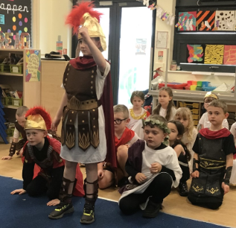
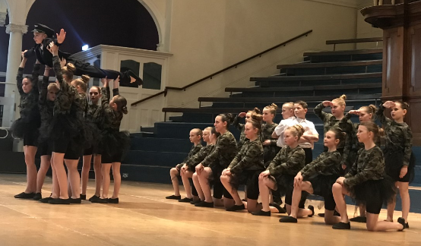
Dance within the National Curriculum
Early Years Outcomes covered in the Dance units are:
• Moves freely and with pleasure and confidence in a range of ways, such as slithering, shuffling, rolling, crawling, walking, running, jumping, skipping, sliding and hopping.
• Experiments with different ways of moving.
• Children show good control and coordination in large and small movements. They move confidently in a range of ways, safely negotiating.
• Enjoys joining in with dancing and ring games.
• Beginning to move rhythmically.
• Imitates movement in response to music.
• Begins to build a repertoire of songs and dances.
• Children sing songs, make music and dance, and experiment with ways of changing them.
• Developing preferences for forms of expression.
• Uses movement to express feelings.
• Creates movement in response to music.
• Captures experiences and responses with a range of media, such as dance.
• Initiates new combinations of movement and gesture in order to express and respond to feelings, ideas and experiences.
• Children represent their own ideas, thoughts and feelings through dance.
Key Stage 1:
Developing balance, agility and co-ordination, and begin to apply these in a range of activities.
Develop a musicality and rhythm further.
Perform dances using simple movement patterns.
Key stage 2:
Develop flexibility, strength, technique, control and balance
Perform dances using a range of movement patterns and different styles.
Build on their own choreography.
Compare their performances with previous ones and demonstrate improvement to achieve their personal best.

Slide 3
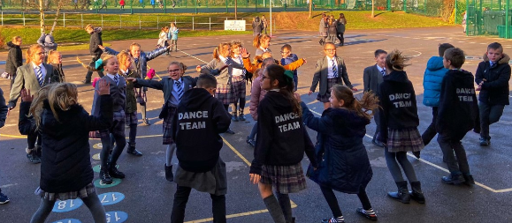
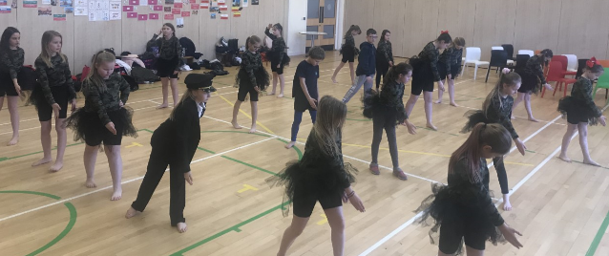
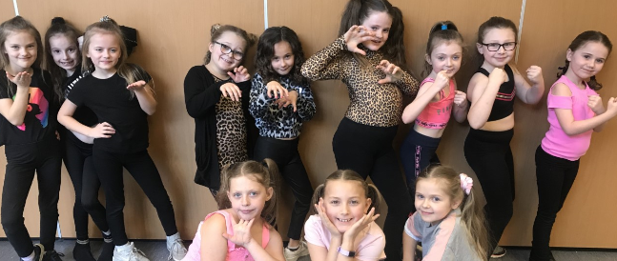
Progression in Dance at SHA
 | Foundation | Year 1 | Year 2 | End of KS1 Outcomes:
Physical Skills | I can travel, stretch & move various body parts in a range of shapes and directions. I can balance in different ways I can differentiate between a skip, walk, hop, march, side step. I can use different levels | Vary the speed, level and direction of my actions You can differentiate and see control between and in my movements. Co-ordinate between simple lower and upper body movements. | I can use the size & speed of my actions to create different effects/shapes. I can sustain a static balance I can co-ordinate simple upper & lower body actions | -Children should be taught to perform dances using simple movements. -Begin to show rhythm, speed, level and direction of their movements.
Creative Skills | I can copy/mirror simple actions of a teacher I can respond to music with some awareness of rhythm I can convey simple ideas through movements; exploding, washing, floating etc. | I can follow a simple structure from teacher in order. Respond to music adjusting own rhythm and tempo. Convey ideas through a character or narrative. | I can recall a simple pattern in order I can respond to suggestions; make that more smoother, harder etc. Respond to different types of music differently (rhythm, tempo & mood) | -Use movement imaginatively, responding to stimuli; music, props. -Create and perform own dances using simple movements, including those from different times and cultures.
Interpersonal Skills | I can keep a safe space away from others. I can take turns and listen to others (short period of time) Make appropriate physical contact with peers. | I can work safely with others, work with a partner safely. Listen to other ideas and take turns. | I can work with a range of people I can discuss my ideas with them. | -Express and communicate ideas and feelings

Slide 4
 | Year 3 | Year 4 | Year 5 | Year 6 | End of KS2 Outcomes:
Physical Skills | I can use stillness and speed effectively Move in a variation of ways with control. I can co-ordinate between my upper & lower body movements. | I can turn, jump, travel using different pathways & use stillness with control. Adjust movements to fit style of dance | I can pay attention to the stillness, tensions & extensions of my body. Travel, turn, make gestures, jump, balance & move with control and in time with music. | Change rhythm, speed, level and direction with consistency. Dance with control and co-ordination as well as in the correct style/mood/character. | Children should be taught to create dances using a range of movement patterns, including those from cultures, styles or characters. Through dance, develop flexibility, strength, technique, control and balance. Perform dances using all ranges of movement developed with control.
Creative Skills | Perform pair/group dance involving canon & unison, mirroring & contact. Respond to music in time & rhythm to show mood. Recall a pattern of moves accurately. | Respond imaginatively to stimuli related to character/music/story. Perform clear & fluent dances that show sensitivity to idea/stimuli. Make up dance within a pair or group. | Show fluency/control in chosen dances in response to stimuli. Begin to use appropriate terminology. Adapt & refine (in pair/group), dances that vary direction, space & rhythm. | Create & perform dances in a variety of styles consistently. Be aware of & use musical structure, rhythm & mood & can dance accordingly Use appropriate criteria & terminology to evaluate performances. | With the skills learnt they will now begin to explore creatively how they could make it work to different music/stimuli
Interpersonal Skills | I can work well with a range of people sharing my ideas and responding well to others. Offer & receive constructive feedback | I can work well with a range & different group size of people. Receive feedback in a constructive manner & give appropriate feedback to others. | I can work well with a range of people sharing my ideas, responding well to others and combining ideas. Receive feedback in a constructive manner & give appropriate feedback to others. | I can work well with a range of people, listen, watch and develop skills together. I can receive feedback in a constructive manner and apply it immediately | Teamwork skills improved. Confidence in subject has improved. Enjoy & evaluate own & each others work.

