Slide 1






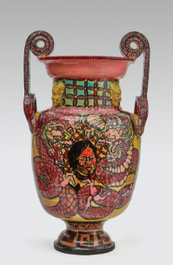
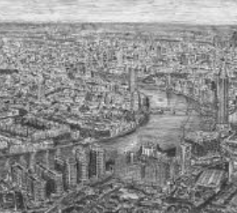
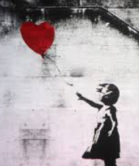


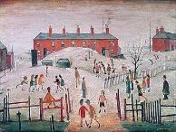
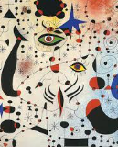
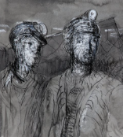
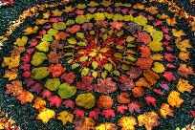
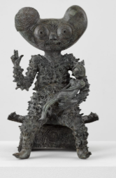
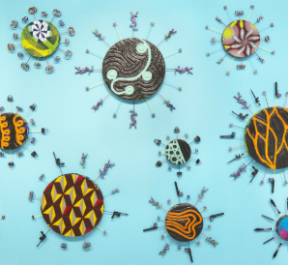
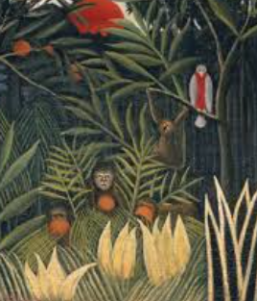
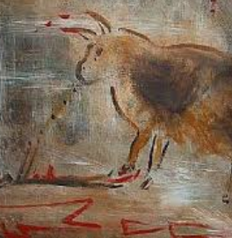
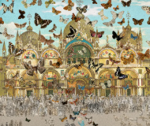
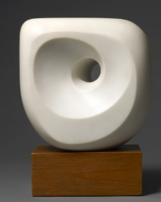
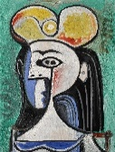
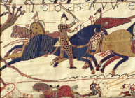
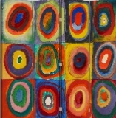
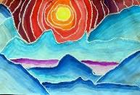
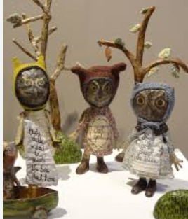
ART: WHOLE SCHOOL JOURNEY
“Every child is an artist…”
- Pablo Picasso
OUR ARTFORMS
Digital Media
Painting
Making with materials
Drawing
Printing
Artist: Robert Lugo
Pottery- sgraffito
Artist: Stephen Wiltshire
Drawings of the local area
Artist: Banksy
Stencils-Propaganda posters
Y5/6 O
Artist: L S Lowry:
Painted industrial landscapes
Artist: Juan Miro
Abstract painting
Artist: Henry Moore
Miners Portraits in charcoal
Y5/6 E
Artist: Andy Goldsworthy:
Natural art
Artist: Grayson Perry
Symbolic paintings
Artist: Yinko Shonbari
Africa inspired printing
Y3/4 O
Artist: Frida Kahlo
Rainforest paintings
Artist: Laura Barbosa
Cave Art
Artist: Peter Blake
Assemblage collage
Y3/4 E
Artist: Barbara Hepworth
Seascape sculptures
Artist: Pablo Picasso
Portraits
Artist: Jordy Kerwick
Mythical Creatures
Y1/2 O
Y1/2 E
Artist: Wallisy Kandinsky: Fabric Printing
Artist: Ted Harrison:
Arctic scenes
Artist: Julie Arkell-woodland creatures
Year R

