Slide 1

Year 6
Programme of Study

Slide 2
Important note for Parents / Carers
As part of our RSHE programme of work (which starts in Foundation Stage and builds throughout school) , we culminate with a specific programme of work for our Year 6 pupils based on changes to our bodies, emotions and sex education.
The following is a synopsis of the work we will cover.
We require permissions to deliver this programme of work.
It is imperative that you complete the link on our website / at the end of this powerpoint. This gives the ability for you to grant permissions for us to deliver ALL or SOME of the content.
If you have any questions, please just contact
y56@sparkenhill.com or kgardiner@sparkenhill.com

Slide 3
Sparken Hill Academy
(Programme of study)
This is what we will cover during the seven lessons. Here you will find examples of slides, animation (snap shots), worksheets and areas for discussion

Slide 4
Seven Lessons
Ground rules & Emotional changes of puberty.
How the female & male body changes at puberty.
Male & Female reproductive system.
Summary & consolidation of changes during puberty.
Periods (menstrual cycle)
Making babies- sexual intercourse / stages of conception.
Making babies- pregnancy & birth

Slide 5
To support a safe learning environment
‘MOST girls’ and ‘MOST boys’ used in delivery as all children are at different stages of development / maturity.
Question box available in all lessons.
Issue of embarrassment addressed at the outset.
Ground rules set : laughing with not at.

Slide 6
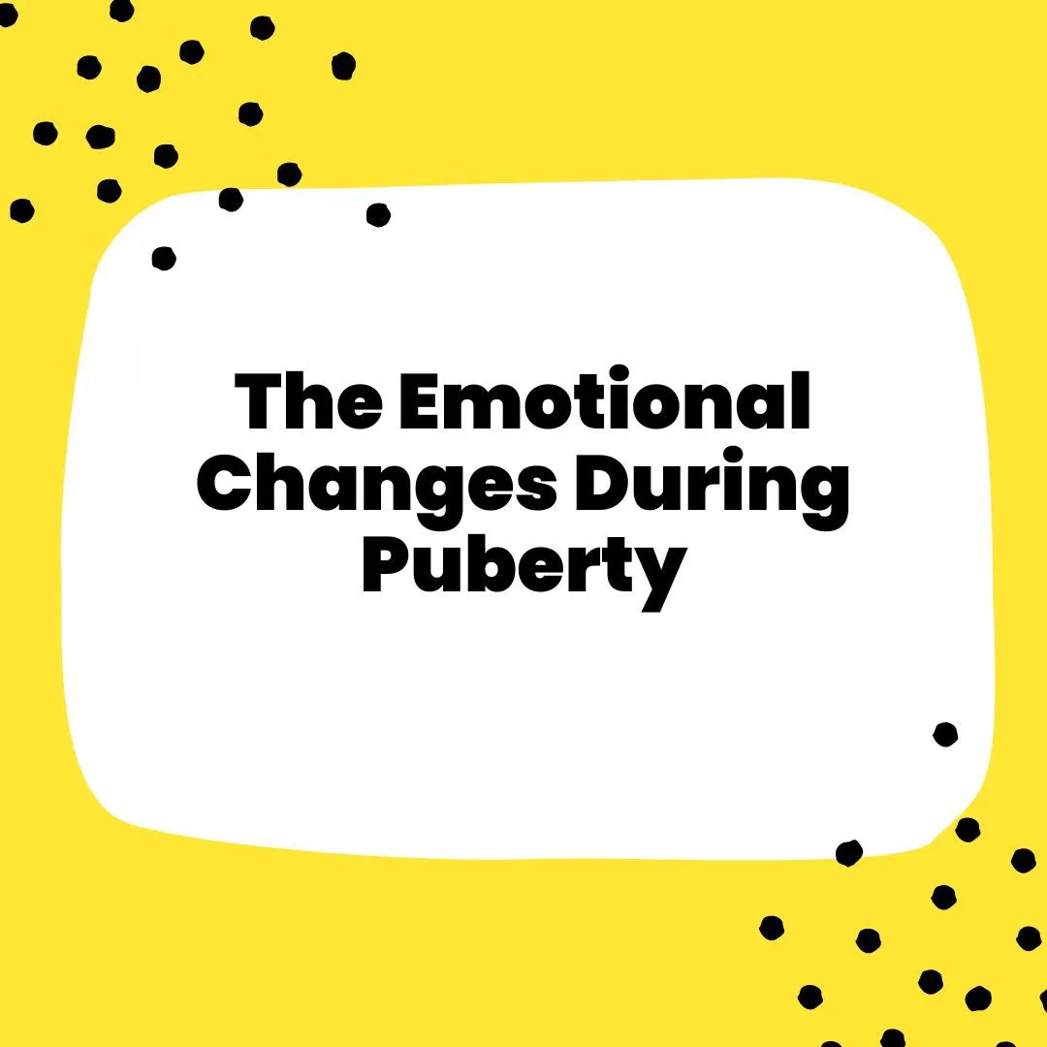
1.Ground rules & Emotional changes of puberty
Key Questions
What is puberty?
How and why do our emotions/feeling change?
How can we manage these changes?
Lesson Objectives / Key learning
To identify emotional changes that could happen during puberty.
To understand the emotional changes at puberty.
I can suggest who to talk to when I need help dealing with the changes at puberty.
I can ask for support for any changes that are difficult to manage.

Slide 7

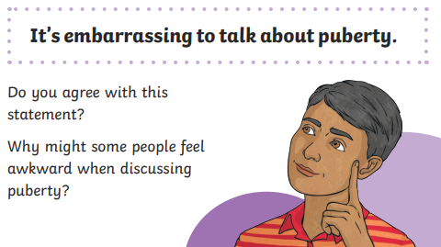
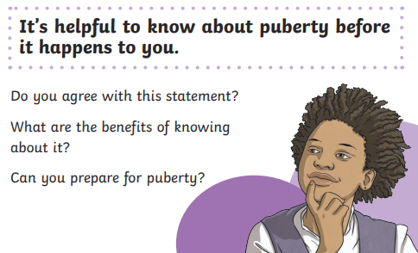
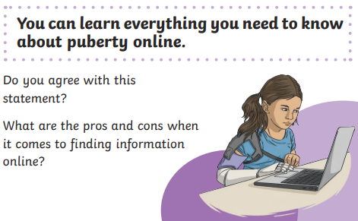
1. RSHE Puberty Discussion Cards

Slide 8
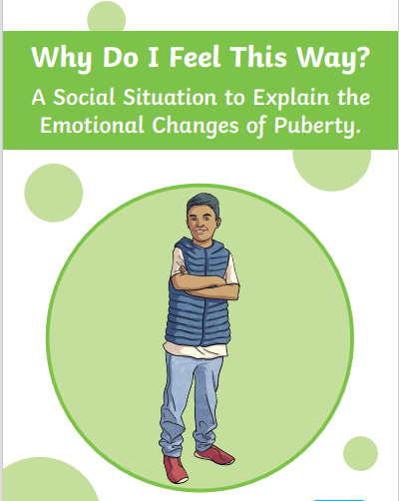

Slide 9

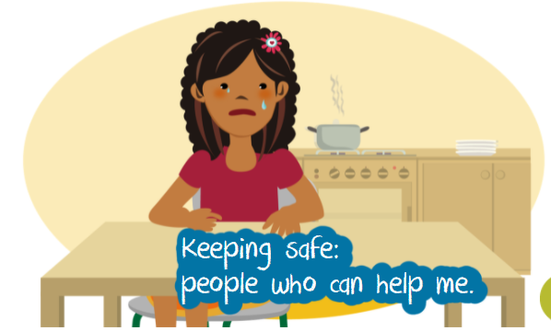
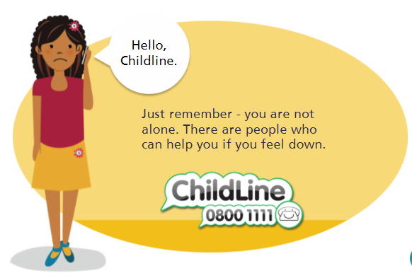
Getting Help
Talk to your class teacher or teaching assistant.
It is good to talk no matter what the issue.
There is nothing too awful or small that I can not talk to someone about it.
Talk to an adult from the Community Team.

Slide 10

2. How the female & male body changes at puberty.
Key Questions
What happens during puberty?
What are the correct names for the parts of the body?
What problems might people have during puberty?
How can these problems be managed?
Lesson Objectives /
Key learning
To identify physical changes that happen during puberty in both the male & female body.
I can suggest who to talk to when I need help dealing with the changes at puberty.
I can ask for support for any changes that are difficult to manage.
Anonymous Question box

Slide 11
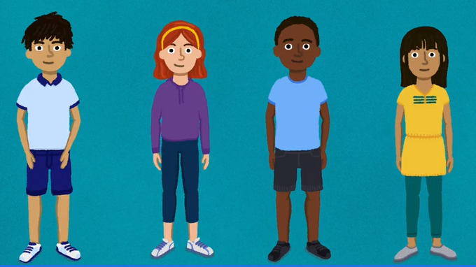
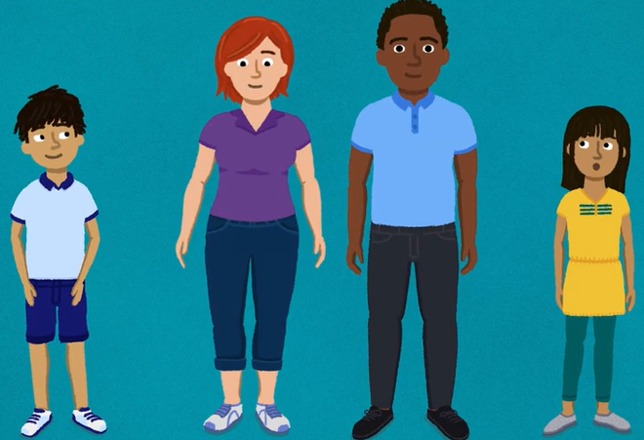
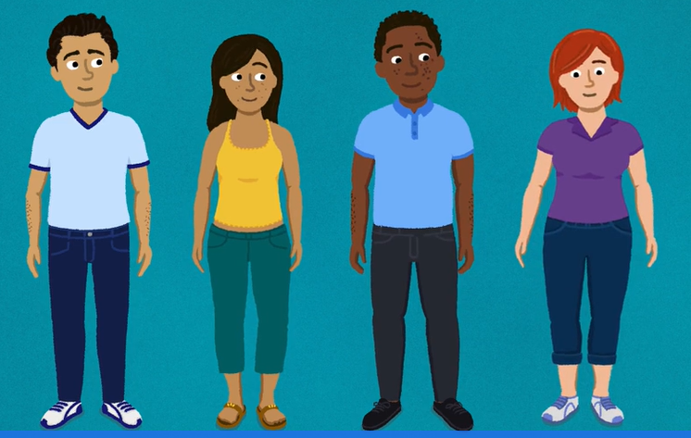
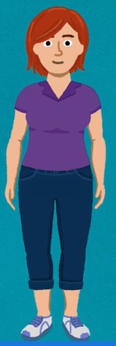
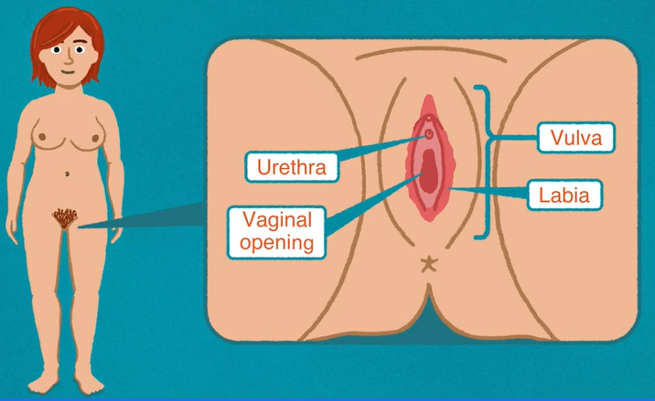
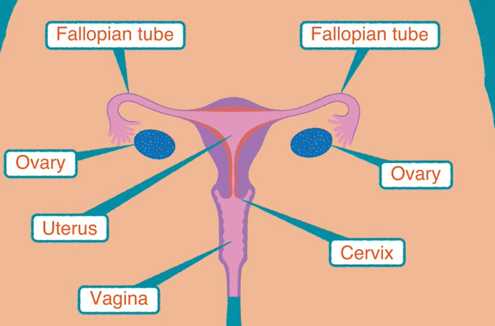
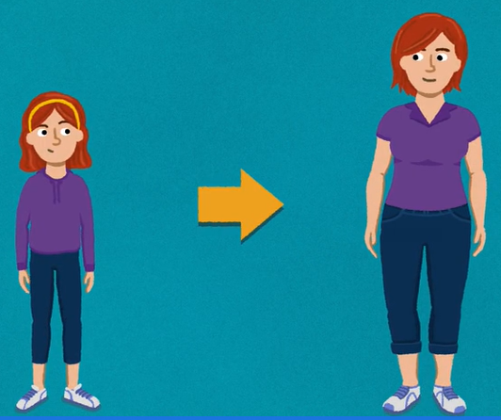
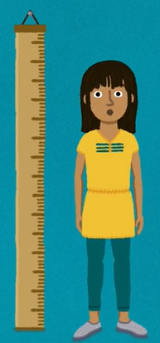
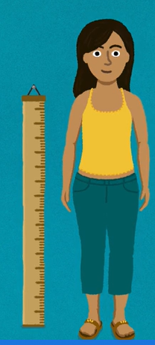
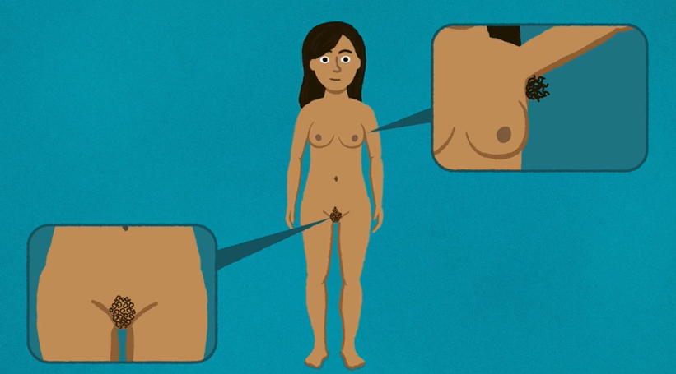
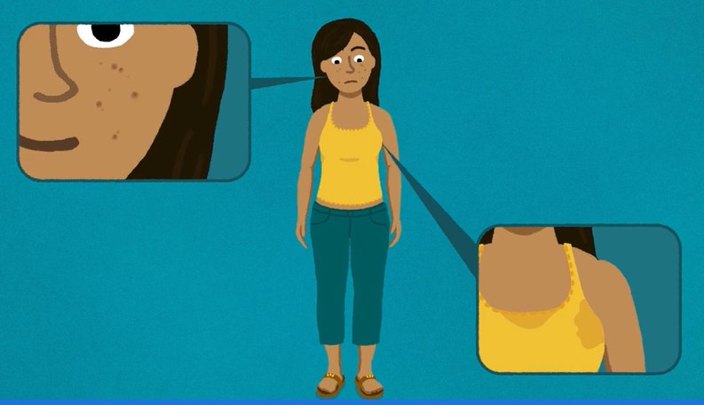

Video screen shots

Slide 12
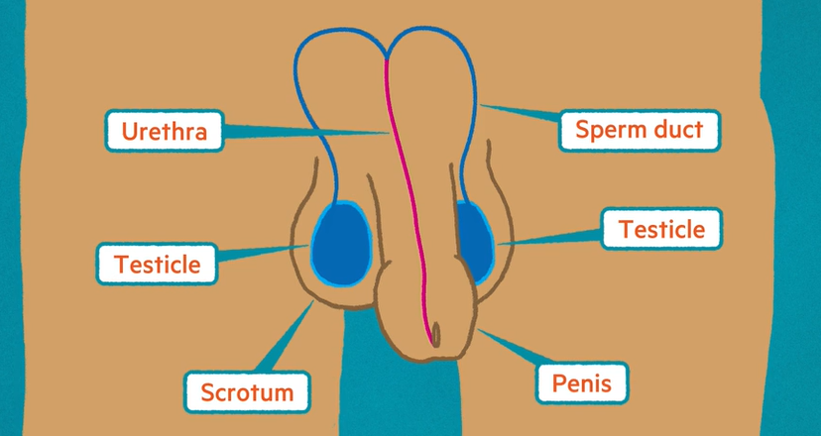
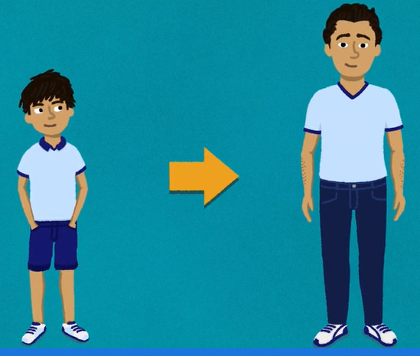
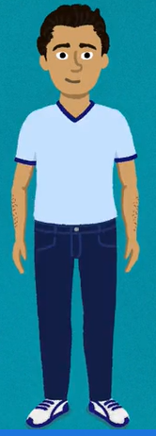
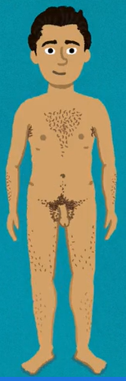
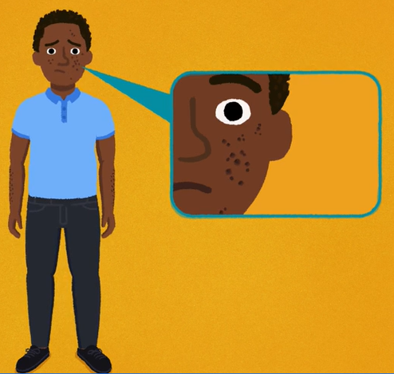
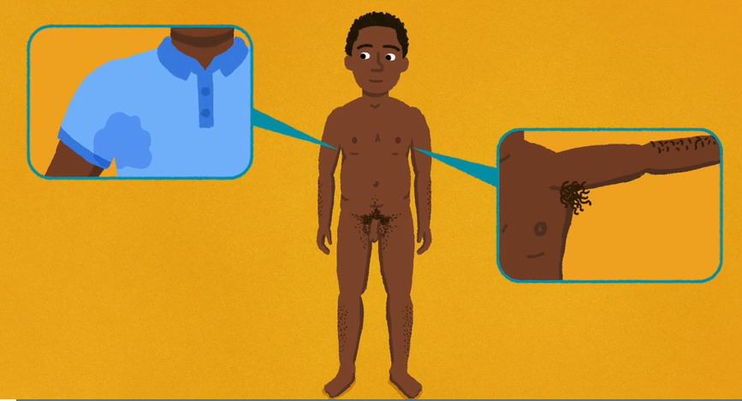
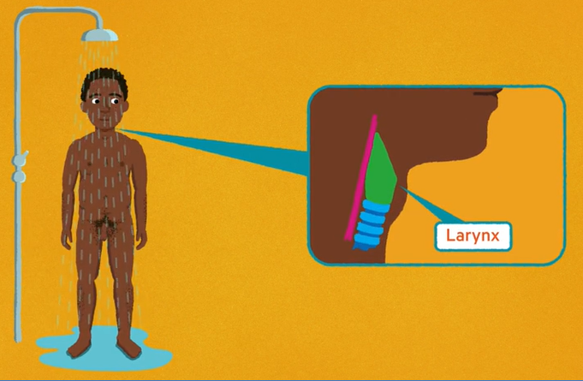

Video screen shots

Slide 13
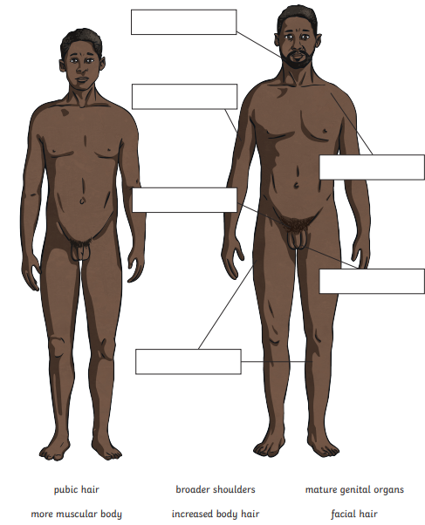
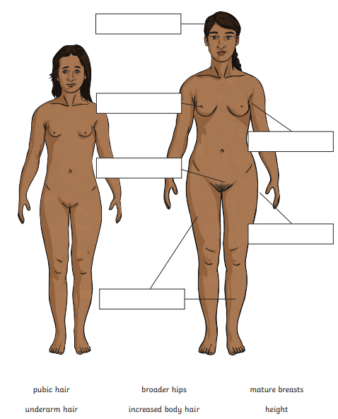
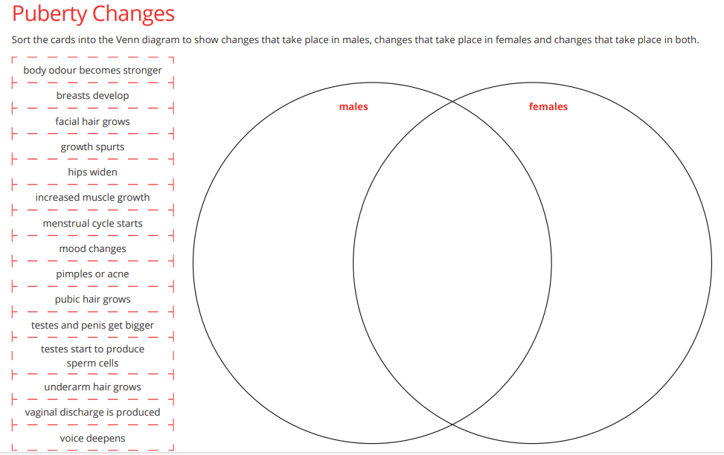
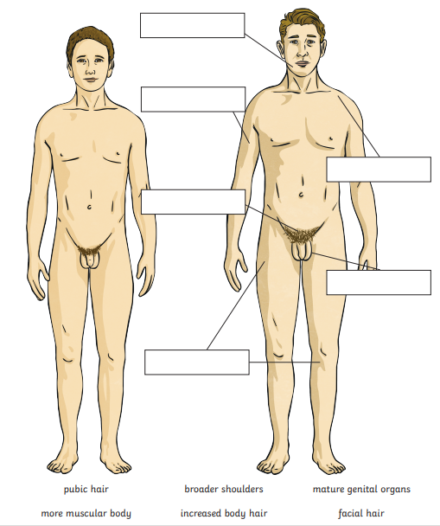
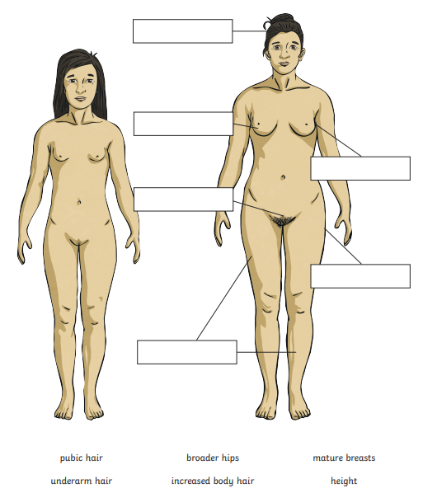
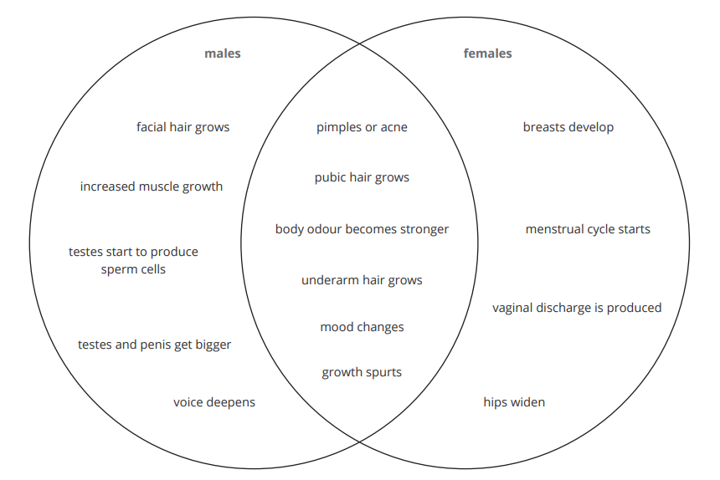

2. Children’s Session Worksheets

Slide 14
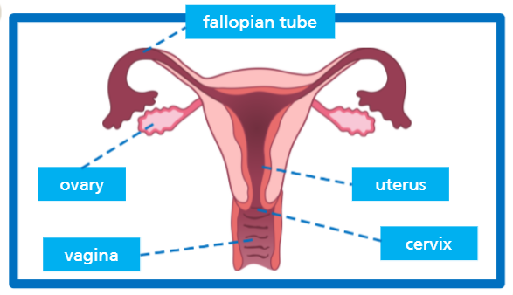
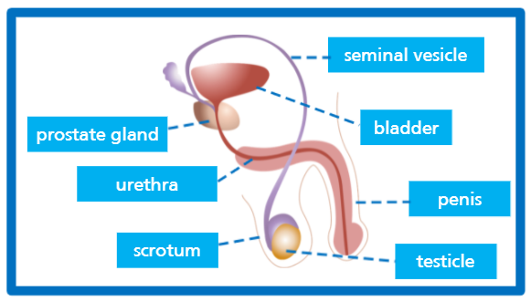
3. Male & Female reproductive system.
Key Questions
What are the key parts of the male reproductive system?
What are the functions of each part of the male reproductive system?
What are the key parts of the female reproductive system?
What are the functions of each part of the female reproductive system?
Lesson Objectives &
Key learning
To identify and label the function of each of the reproductive parts of the male and female reproductive system.
To understand and explain the function of each of the reproductive parts of the male and female reproductive system.

Slide 15
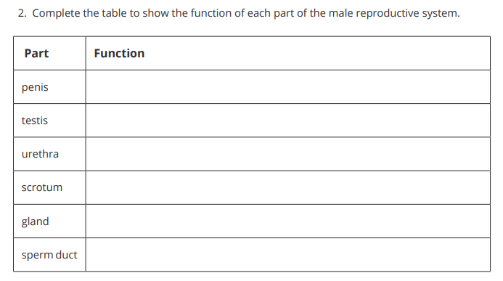
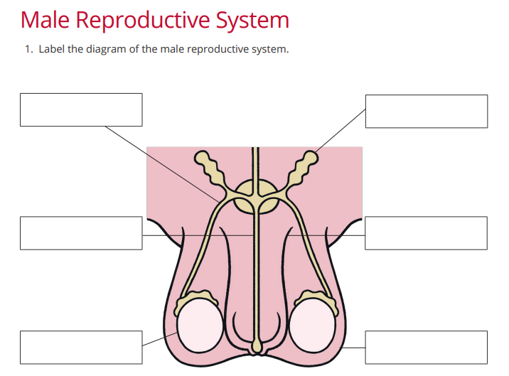
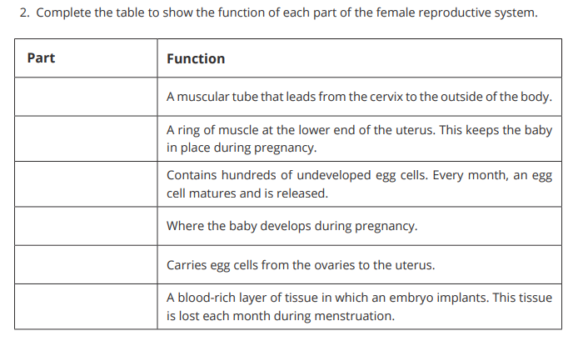
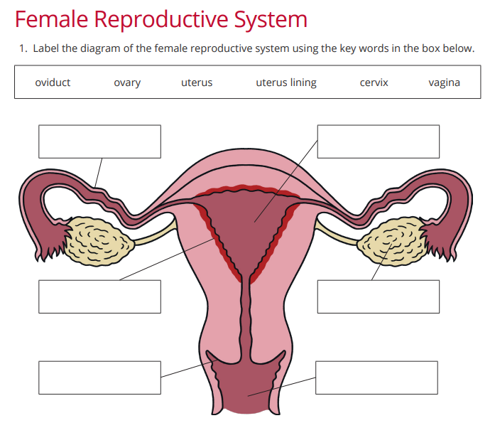
3. Children’s Session Worksheets

Slide 16
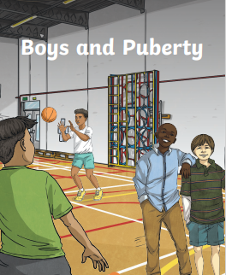
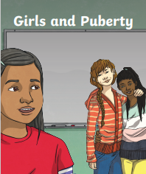
4.Summary & consolidation of changes during puberty.
Key Questions
What happens to my body as I go through puberty?
Why do these changes take place?
Do I need to start doing anything differently when I start puberty?
Should I be embarrassed or worried about puberty?
Does everybody experience the changes at the same age?
Lesson Objectives &
Key learning
To recap the main physical changes that happen during puberty in both the male & female body.
To understand how / when and why these changes occur.
To know that emotions and our mood are affected too.
To consider making changes to some health & hygiene routines.

Slide 17
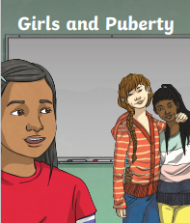
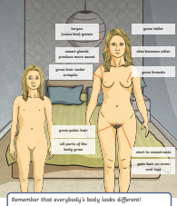
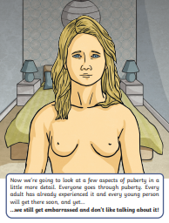
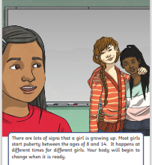
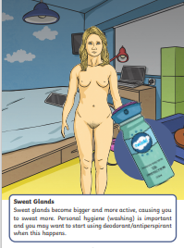
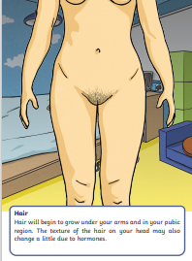
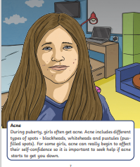
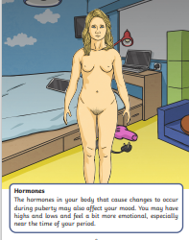
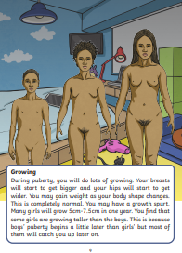
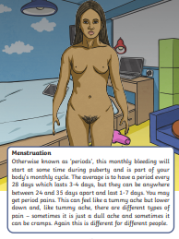
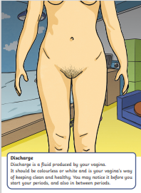

4. Children’s Session Resources
Female e-book

Slide 18













4. Children’s Session Resources
Male e-book

Slide 19



4. Children’s Session
Worksheets

Slide 20




5. Periods (menstruation) delivered separately to boys/girls
Lesson Objectives / Key learning
To learn about periods (menstruation)
To understand the key facts about the menstrual cycle.
To know the products available.
To know how to use and dispose of products used, hygienically & safely.
To be able to suggest ways to overcome possible problems from periods.(menstrual wellbeing)
Key Questions
What is a period?
What is a tampon?
What is a sanitary towel?
What can help with period pain?
Who can help if someone is struggling to manage their period?

Slide 21














OR
Share sanitary products to discuss use & disposal

Slide 22

5. Children’s Session Worksheets

Slide 23



5. Children’s Session Worksheets

Slide 24


6. Making Babies & Sexual Intercourse /
stages of conception (parents have the right to withdraw their child from this lesson.)
Key Questions
What is sexual intercourse?
Why do people have babies?
How do people have babies?
What is consent?
At what age can people legally have sexual intercourse?
Lesson Objectives / Key learning
To learn and understand how babies are conceived as part of the human life–cycle.
To be able to describe fertilisation through sexual intercourse.
To be able to explain what consent means.
To know the age of consent.

Slide 25














OR

Slide 26


6. Children’s Session
Worksheets

Slide 27







6. Children’s Session Worksheets
(Let’s talk about sex Quiz)

Slide 28





7. Making Babies – Pregnancy & Birth
(parents have the right to withdraw their child from this lesson.)
Lesson Objectives / Key learning
Key Questions
How does a baby grow / develop in the uterus / womb?
How are babies are born?
Does it hurt?
What does a baby need in the first months of life?
What other options are there for couples wanting a baby?
To understand the development of the baby during pregnancy.
To know how long an average pregnancy lasts.
To explain why a pregnancy lasts approximately 40 weeks (9 months).
To identify & explain why some things should and should not be eaten in pregnancy.
To explain & describe how babies are born (delivered).

Slide 29















Slide 30


7. Children’s Session
Worksheets

Slide 31


Slide 32

7. Children’s Session
Worksheets

Slide 33

Marie is pregnant. Which of these things should she take a lot of, the things she should take a little of and the things she should never take especially during pregnancy.

Slide 34

IMPORTANT:
For pupils to access and participate in this programme of study and course of lessons the school needs explicit permission from parents prior to delivery and onset of this teaching.
Click here to complete the permission link (note: if you do NOT give permission, you will also need to use this link.)

