Slide 1


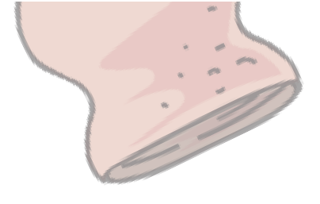


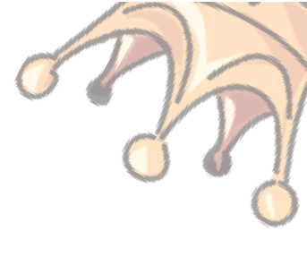


















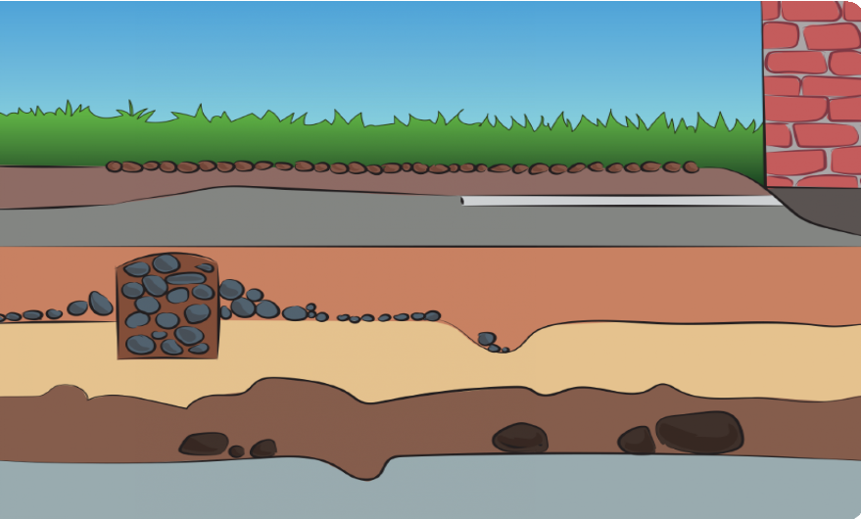

The Stone Age
LKS2 History
Knowledge organiser
Britain
Roundhouses built
4500 BC
Farming introduced
3000 BC
Stonehenge built
2000 BC - 1800 BC
100 BC
First coins minted
AD 117 AD 500 - AD 927
Roman Empire at its height
AD 1066
The battle of Hastings
Beaker people
The Heptarchy of England
Hunter-Gatherer life
Palaeolithic
Mesolithic
Neolithic
Bronze Age
Iron Age
Romans
Anglo-Saxons and Vikings
2,000,000 BC
10,000 BC
4000 BC
2000 BC
800 BC
AD 43
AD 410
AD 1066
The Stone Age
How do we know about the Stone Age?
The Stone Age is a period of our history that happened thousands of years ago. It is called the Stone Age because it is the era when early humans started using stone for tools and weap- ons. They also used stones to light fires.
There is no written evidence from the Stone Age era. Instead, archaeologists dig to find clues about how people lived before written records existed. Artefacts such as bones, jewellery and pottery have been found deep in the ground and help
archaeologists piece together what life was like in different eras. The deeper in the ground that the archaeologist find artefacts, the older it is.
The Stone Age is divided into three periods; the Palaeolithic (old Stone Age), Mesolithic (middle Stone Age) and the Neolithic (new Stone Age).
Palaeolithic and Mesolithic people were hunter gatherers. They moved frequently following the animals they hunted and gathered fruits and berries when they could.

Slide 2
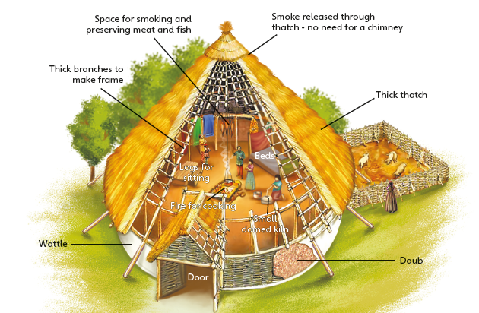
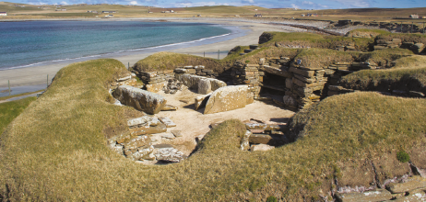
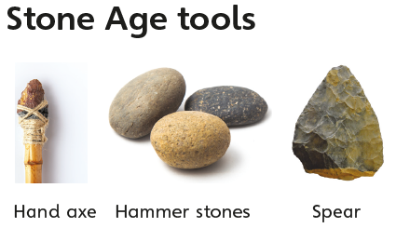
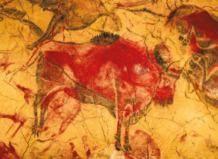


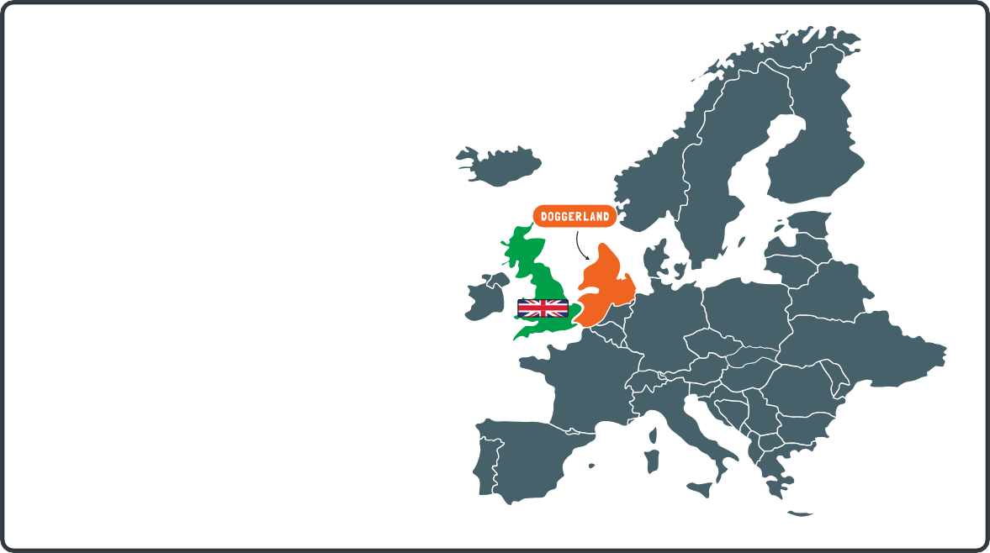
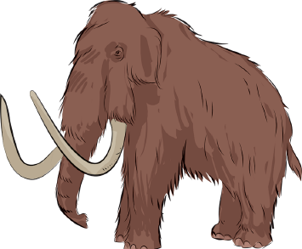

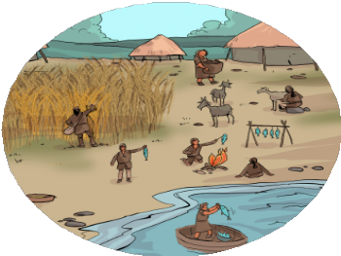



We have
evidence of humans living in caves from paintings on the walls.
Skara Brae
Hunter-Gatherers
During the Stone Age, Britain was very different. It was originally connected to the rest of Europe by a piece of land called Dogger- land.
People living during the Stone Age were hunters. They would hunt animals to eat such as woolly mammoths, reindeers and woolly rhinoceros. However, they did not just hunt animals to eat them. Animals had many different uses. They would use the animal’s woolly coat to keep them warm in the winter and they would use animal horns as tools, weapons or even to help clear snow out of their path!
Doggerland eventually disap- peared when the sea level rose over thousands of years.
Archaeologists believe that many people lived here during the Stone Age.
Ivory, bone and sinew to make tools and weapons
Meat to eat and fat to create paints for artwork
Farming
Fur to make clothes
During the Neolithic Stone Age, people started to settle and not follow animals. They would plant the seeds from the plants they gathered and looked after them so that they would grow. When the plants were fully grown, the
people would use their stone and bone tools to cut the plants, so that they could turn it into food and eat it. People also captured smaller animals such as dogs, pigs and sheep. They looked after them so that they would have babies. This meant that they would have bigger groups of animals near their homes that they could milk, skin for hides/fur and kill for meat/bone for food and tools.
The animals would often migrate around the land, not staying in one place. People during this time built temporary homes so that they could move quickly to follow the animals and continue to hunt. The Stone Age people also ate fish that were caught in rivers and lakes, gathered animals eggs, fruits, nuts and plants.

